Slide 1
Chapter 4 – Value and Risk

Slide 2
Module 1
Value and Risk and VaR

Slide 3

Statoil – An ERM Success
Notes:
The point of risk management as a whole organization within Statoil is to
Create value
Avoid accidents – keeping people and the environment safe – pg 61
Initially ERM was lead as a finance objective which expanded to a company wide integration of thought- pg 61
Statiol ERM captures both downside risk and upside risk using the risk map- pg 62
ERM keeps the perspective that the company as a whole should rule in practical situations where different individuals and business units may have differing views on how to proceed. pg 64
It is crucial that change is not resisted to ensure ERM does not become an island, or an isolated process whose outputs are opinions that are largely ignored by decision makers. pg 59
ERM should be inclusive of the firms future performance, financial performance risk, and financial statement reporting – pg 68

Slide 4
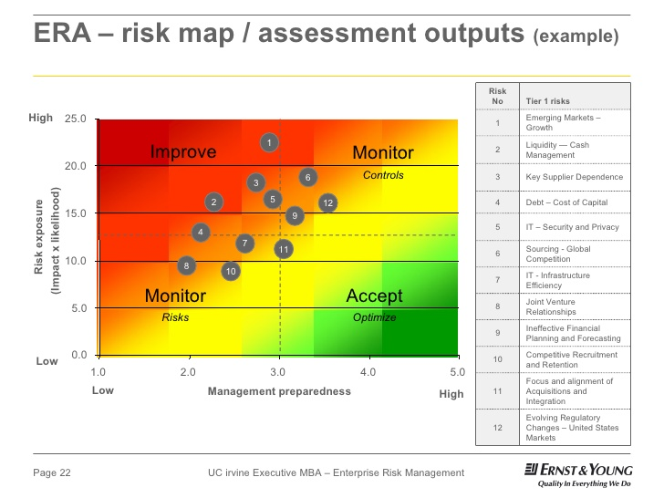
Typical Risk Map
http://image.slidesharecdn.com/uciembafcdjuly2009boardgovernanceenterpriseriskmanagement-124814741935-phpapp02/95/uci-exec-mba-amp-forum-for-corp-directors-july-2009-board-governance-enterprise-risk-management-erm-22-728.jpg?cb=1248129564

Slide 5

What is Enterprise Risk Management?
https://www.bing.com/videos/search?q=Enterprise+Risk+Management&&view=detail&mid=4953B62B396EF8BB4A584953B62B396EF8BB4A58&FORM=VRDGAR

Slide 6
Chapter 3 – ERM at Mars, Incorporated

Slide 7
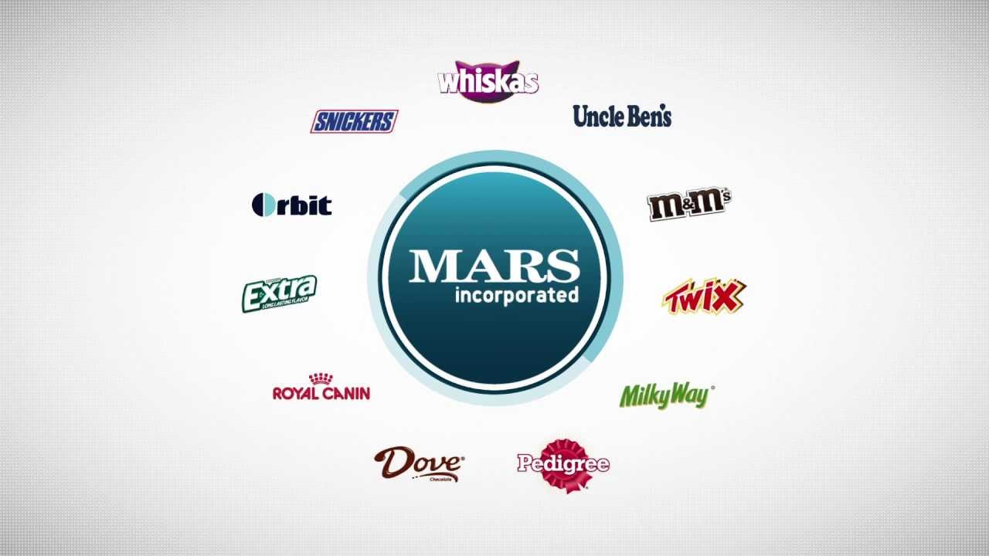
ERM integration at Mars, Inc.
Notes:
Company core focus was on ERM and not enterprise compliance management – pg 40
Object of ERM was to provide the company with a proven, sustainable framework to proactively understand and deal with complex business risks, both tangible and intangible, existing and emerging, across the entire organization. – page 42
Viewing risk as an opportunity meant a cultural shift for the whole organization– page 42
Mars ERM system began by having summary workshops across country focused on teams. A facilitator was used and a risk profile scoring system that integrated a 5 color coding system that eventually was a company-wide reporting system- page 41-47
A ERM Dashboard template was created which was required to be updated on a quarterly basis of initiatives by risk followed by timely quarterly tracking– page 48 & 49
Output of the ERM workshops produced both quantitative and qualitative data, as well as tangible and intangible risks. These included operational, supply chain, and human resources risks. The human recourses issues rose to be near the top of the list priority throughout the Mars world footprint – page 52 & 53
Signing accountability to specific actions of resolution of risks was found to be crucial for completion of the tasks – page 84

Slide 8

ERM Success Factors Within Mars – pg 97
Notes:
Ensured the ERM program aligned with company approved principles
Focused on achieving operational and strategic objectives integrated with ERM. Compliance was not addressed and was left to a different department. However, all information was shared with compliance
Evolution was the focus and not revolution, thus change management was a slow progression over years and evolved a continuous improvement process
Flexibility was a key component of success. Rigidity was not allowed in developing workshops and updating processes so that they best met unit needs. The program had a demand for services as opposed to a push of services mentality
The ERM process proved to be a good identifier of talent and opportunity for associate development within the organization
ERM team never compromised what it could deliver. Realistic objectives were set on rollout and gained senior management support immediately from the beginning
Periodic surveys were engaged and conducted through various teams and levels of the organization to allow continuous improvement

Slide 9
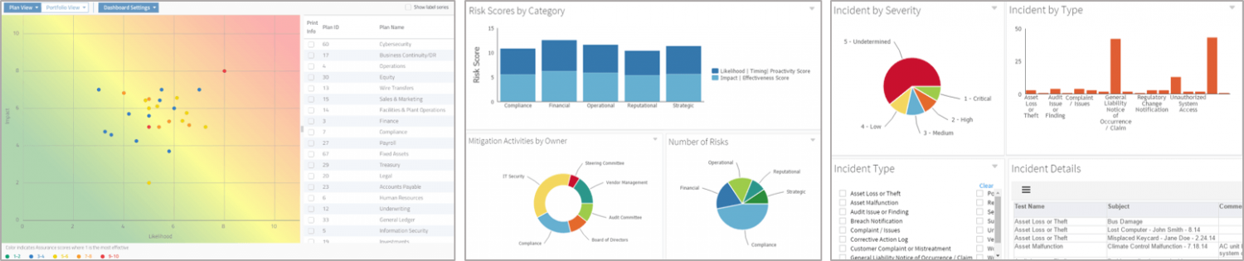
Risk Management Dashboard
https://www.logicmanager.com/wp-content/uploads/2016/12/Risk-Dashboards-and-Reporting-1500x315.png

Slide 10
Chapter 24 – The Role of Var in Enterprise Risk Management

Slide 11
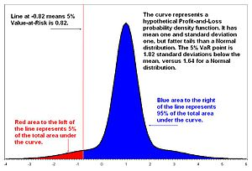
Risk and Value – VaR Calculation
Notes:
Risk relates to the possibility of an unexpected outcome and is inherent in every organization – pg 400
Risk = volatility. It is measured by a standard deviation – pg 400
Measurement of risk tied to downside movement is called VaR and is an integral comparison to generate a single probabilistic statement based upon portfolio risk – pg 400
It is the likelihood and magnitude of impact of events or circumstances for the firm’s objective, including both risks and opportunities – pg 400
Var summarizes the worst loss over a target horizon within a given level of confidence –pg 400
Var has three methods of calculation: historical, parametric, and monte carlo – pg 401

Slide 12
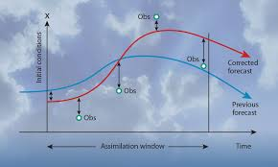
VaR Advantages/Disadvantages – pg 491
Notes:
Advantages
Measure of total risk in one number that is fairly easy to understand
Applicable to portfolio comparisons of volatility in a dollar value
Comparisons can be made between the portfolio and the market
Disadvantages
VaR is somewhat of an untested model
It could provide a false sense of security
It does not give the absolute downside of the risk and thus gives a false sense of security
VaR is not a worst case scenario or a maximum tolerable loss calculation and can be easily misunderstood
The calculation should be used in conjunction with other ERM calculations and is only one point on a ERM dashboard or risk management system

Slide 13
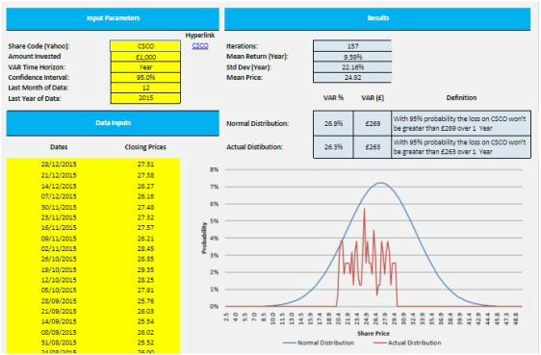
VaR Analysis
http://www.financewebapps.com/uploads/5/4/2/2/54227365/7673309.jpg?1458983198

Slide 14
References
John R.S. Fraser, B. J. (2015). Implementing Enterprise Risk Management. New Jersey: Wiley & Son, Inc.,

